Slide 1

Notes to Instructor
Material Needed
Hard copies of the following:
ADaM Model Document v2.1
ADaM IG v1.1
ADaM Data Structure for Occurrence Data v1.0
ADaM Basic Data Structure for Time to Event v1.0
FDA Study Data Technical Conformance Guide with labelled Post-It notes attached to the first page of each document
Each participant will need to bring their laptop to access workshop templates needed to complete workshop exercises
Excel file Exercise Templates and additional electronic resources on the External SharePoint site

Slide 2
Electronic Documents Required
ADaM Workshop Module 2.pptx (this power point)
Participants will need the following for exercises:
Lilly ADaM Mod 2 Exercise.xlsx
Lilly Core_ADaM_ADAE_v8.xls
For Reference:
ADaM Model Document v2.1
ADaM IG v1.1
ADaM Data Structure for Occurrence Data v1.0
ADaM Basic Data Structure for Time to Event v1.0
FDA Study Data Technical Conformance Guide
CDISC ADaM Validation Checks V 1.3

Slide 3
Lilly Workshop Module 2 ADaM Metadata, Reviewer Guides and Compliance

Slide 4
Objectives
Encourage participation to enhance learning in this hands-on workshop
Appreciate that clear and informative metadata is critical to achieving ADaM fundamental principles
Identify the types of metadata for ADaM and the value of each metadata element
Become familiar with the purpose of an Analysis Data Reviewer’s Guide
Understand the process for establishing compliance for ADaM data sets

Slide 5
The Importance of Metadata

Slide 6

ADaM Principles Recap
ADaM Principle #1
Analysis data and associated metadata must facilitate clear communication of analyses and conclusions
ADaM Principle #2
Analysis data must provide traceability
between the analysis data set and the
source data (SDTM)

Slide 7
Achieving ADaM Principles
How do we achieve clear communication?
How do we achieve traceability?
We can achieve ADaM principles, in part, by having informative and accurate metadata

Slide 8
Achieving Traceability
There are 2 ways to achieve traceability
METADATA Traceability
DATA POINT Traceability
Metadata traceability is required
Data point traceability should be used where feasible
We will discussed Data Point Traceability in Module 3

Slide 9
Metadata Traceability Defined
Metadata traceability facilitates the understanding of the relationship of the analysis variable to its source dataset(s) and variable(s)
This traceability is achieved by using metadata (text) to describe the algorithm used or steps taken to derive or populate an analysis variable from its immediate predecessor.

Slide 10


Metadata Is the Key Piece
Metadata is the essential piece of
the puzzle. Without it, the entire
picture is missing
Metadata ties all other pieces (SDTM data
ADaM data, Table results, Define.xml) together

Slide 11

CDISC Metadata
All CDISC models define specific metadata and SDTM, SEND, and ADaM share similar concepts
There is a requirement for metadata to be reflected in Define.xml file
The primary purpose of define.xml is to provide a readable document that will explain the what, why, and how for every dataset
and every variable

Slide 12
Metadata Management
Most sponsors create metadata for to support both programming specifications and representation in Define.xml.
Two different needs:
Specifications: needs to be clear for someone to create accurate SAS code
Define.xml: needs to be clear for someone to accurately read and understand the content of a dataset and derivation of each variable

Slide 13

Tips for Metadata Management
There is no easy button for creating and managing metadata, especially ADaM metadata
Tips:
ALWAYS be aware of need for clear
specifications AND clear text in define.xml
Consider requiring all metadata elements to be present and populated in specifications
Consider creating define.xml early in the process to ensure it is readable and all elements are accurate and present

Slide 14
Tips for Metadata Management
Consider creating both an English readable definition and a programming specification for important variables
For example:
TRTEMFL: Any adverse event that has an observed or imputed start date on or after the first dose date and up to 30 days after the last dose is considerer treatment emergent with TRTEMFL=‘Y’. Otherwise TRTEMFL=‘N’;
TRTEMFL: If ADSL.TRTSDT≥AESTDT≤ADSL.TRTEDT+30 then TRTEMFL=‘Y’. Else TRTEMFL=‘N’
This can be useful for both variables and for the entire dataset. For example:
ADVS contains records from VS for subjects who were randomized (ADSL.RANDDT>.). Data in VS for screen failure subjects was excluded from ADVS

Slide 15
Types of ADaM Metadata
Data Set Level Metadata
Variable Level Metadata
Parameter Value Level Metadata
Analysis Results Metadata

Slide 16
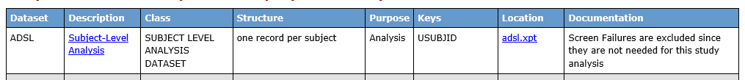
Data Set Level Metadata
Describes key features of the data set as a whole
Data set
name
Structure in
words
Structure in
VARNAMEs
CT for
ADaM
Class
Optional for
documentation
“Analysis” for
ADaM
Link To XPT
Optional for
documentation

Slide 17
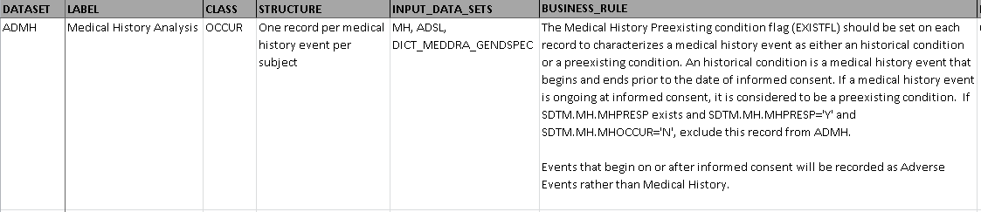
Lilly Core_ADaM_ADMH_V7
Will Documentation element ever be included in define? If so, where does the text come from?
Anything you notice that needs to be updated in this text?

Slide 18
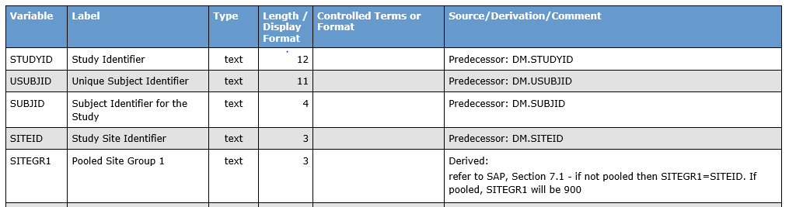

Variable Level Metadata
Describes key features of the variable
Length
Format
Variable
Label
Source, Derivation, and comments
Variable
Name
Type in Define.XML values
Allowable
Values

Slide 19
Source / Derivation / Comments
Why is this the heart of ADaM?
Because it is the primary location for the information that fulfills the requirement to have metadata traceability
Source: the immediate predecessor of a variable.
Derivation: the algorithm used to create a value
Comments: any text that will be helpful to understand the variable content, purpose, exceptions, special cases, etc.

Slide 20
Group Exercise
Open Lilly Core_ADaM_ADAE_v8.xls and locate variable TRTEMFL
What will appear in the Define.xml for this variable?

Slide 21
Parameter Value Level Metadata
Used only for BDS datasets
Parameter Value Level Metadata describes the metadata for any variable that may have different characteristics depending on the value of PARAM

Slide 22
Parameter Value Level Metadata
Variable | Where | Type | Length/ Format | Controlled Terms | Source Derivation /Comment
AVALC | PARAMCD= ‘QUEST1’ | Text | $6 | ‘Never’, ‘Seldom’, ‘Often’, ‘Always | QS.QSSTRESC where QSTESTCD=‘Q1’
AVALC | PARAMCD= ‘QUEST2’ | Text | $10 | ‘Went for a Walk’’, ‘Took a Nap’, ‘Watched TV’ | QS.QSSTRESC where QSTESTCD=‘Q2’
Length
differs
CT differs
Source differs

Slide 23
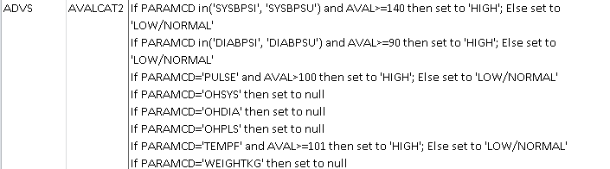
Parameter Value Level Metadata
Excerpt from Core_ADaM_ADVS_V9.xls

Slide 24
Parameter Value Level Metadata
For some analysis datasets, expressing value level metadata using a long string will work
“if PARAMCD in (x, y, z) then AVAL= { derivation text };
else if PARAMCD in (a, b, c), then AVAL= {derivation text };
else if….”
This works best when there are not many differences between parameters for derivations of other columns
When parameters are derived and are based off of different sources, the ‘if then else’ approach does not work too well.

Slide 25
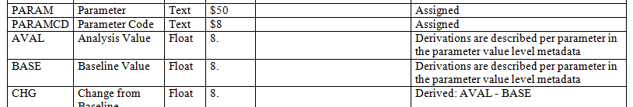
Parameter Value Level Metadata
Define 2.0 provides a method for expressing true parameter value level metadata
When a variable derivation changes based on the value of PARAM, then derivations are described in another metadata table
The following slides show how this metadata would look like in the Define.xml file

Slide 26
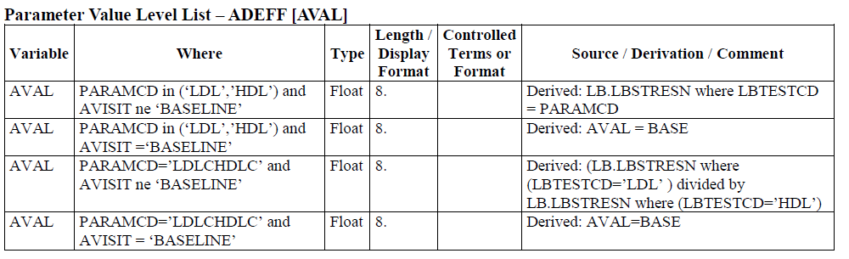
Parameter Value Level Metadata
PVLM is provided for each variable ‘where PARAMCD=‘xxx’. Source Derivation Comment is the specification for how to derive variable when PARAMCD=‘xxx’.
Notice that Length and Controlled Terminology can differ for the specified variable depending on PARAMCD

Slide 27
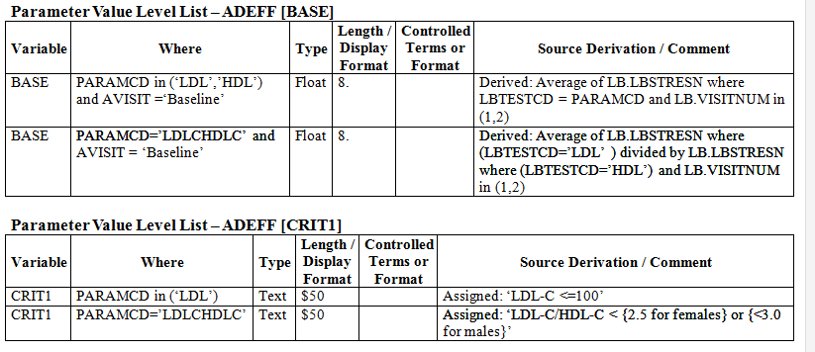
Parameter Value Level Metadata
There is a separate table for every variable that differs by PARAMCD

Slide 28
Parameter Value Level Metadata
Lilly has a method for entering PVLM within the study SST’s.
It is important to ensure this is done properly so that representation in the Define file is correct

Slide 29
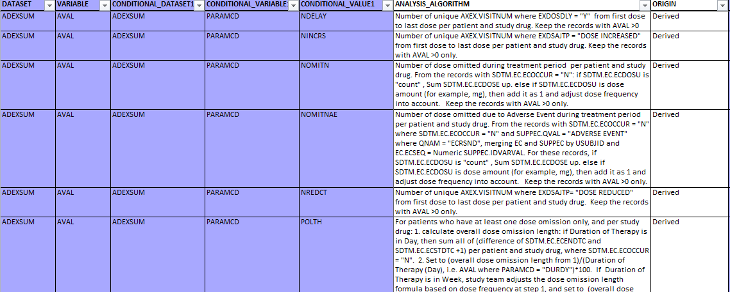
Example from SST

Slide 30
Analysis Results Metadata
ADaM has a special type of metadata that provides traceability regarding the creation of the statistical results
Is not required but is very helpful for primary efficacy analyses
FDA reviewers have indicated it is very helpful for them
This metadata can be reflected in Define.xml

Slide 31
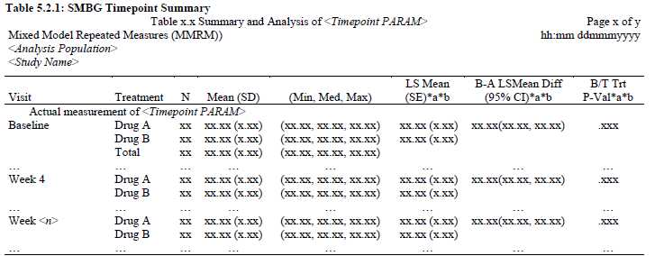
Analysis Results Metadata
…imagine that this table is populated with real numbers…

Slide 32
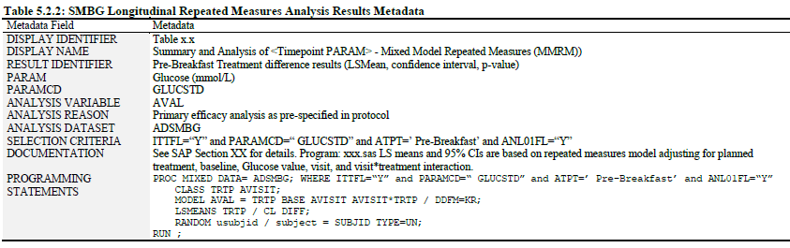
Analysis Results Metadata
ARM indicates Data Set, Variables, Selection statement
and MODEL statements

Slide 33
ADaM Metadata Recap
Creation of good ADaM metadata is key achieving principle of metadata traceability
There are many individual metadata elements that must be maintained
In practice, metadata is used both for programming and for inclusion in Define.xml as a submission requirement
Best practice is to have a method that allows user to specify metadata once and use it many times. Begin with end in mind!
Analysis results metadata should be considered for primary analyses at a minimum

Slide 34
Analysis Data Reviewer Guide

Slide 35
What’s a Reviewer’s Guide?
For years, many sponsors would create a separate document called a ‘reviewer’s guide’ that provided an overview to the submission
The purpose was to provide the reviewer with an orientation to the data that they could not otherwise gain just by looking at define.xml
Content and format between sponsors was variable

Slide 36
Standard Reviewer Guide Templates
In past 3 years, through the effort of PhUSE with FDA support, 2 templates have been created
Study Data Reviewers Guide (SDRG)
Analysis Data Reviewers Guide (ADRG)
The purpose of these templates is to provide a predictable structure and content to the reviewer guide documents
The templates are meant to be flexible with very little content being required
The reviewer guides are highly recommended, not required

Slide 37
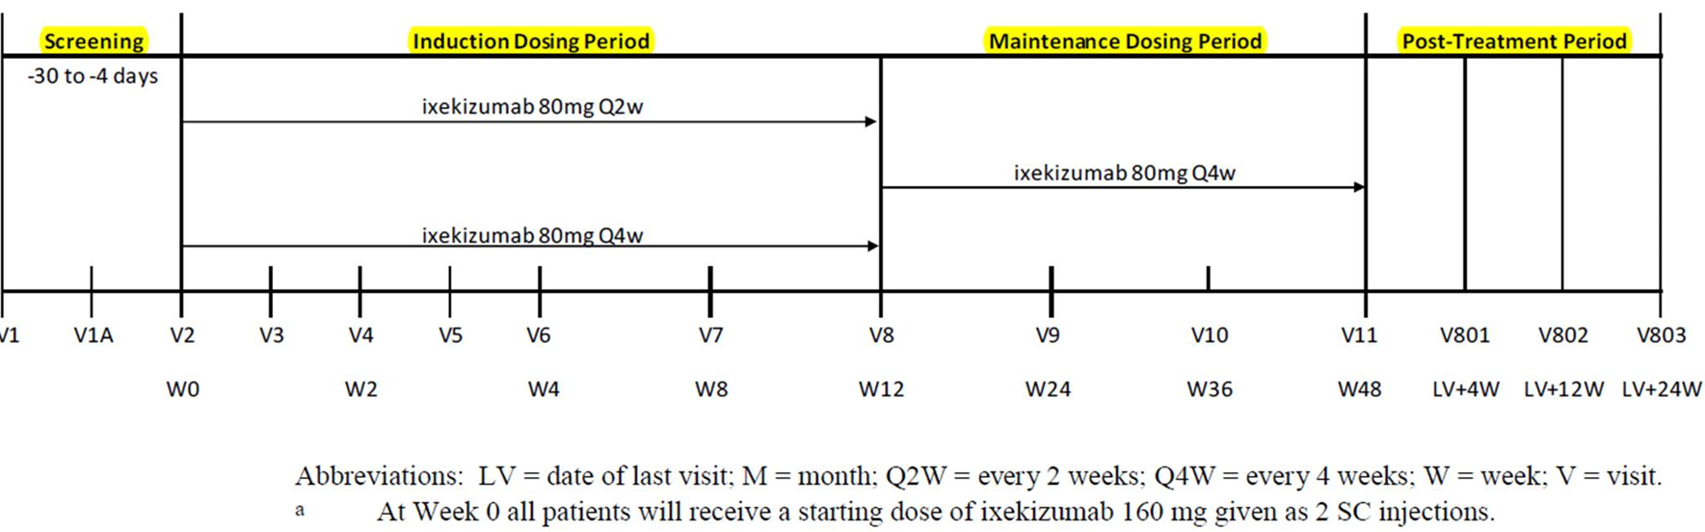
ADRG Highlights
Describe or show how protocol design is expressed in ADaM
Use of APHASE
Number of treatment periods
Number of analysis periods
Comparison of SDTM and ADaM content for any shared data concepts such as
Screen failures
Baseline values
Any differences in content due to data cutoff issues
Values of ARM versus TRTxxP
RFXSTDTC vs TRTSDT

Slide 38
ADRG Highlights
Highlight any situations that may cause confusion, e.g.:
Subjects randomized but not dosed
Subjects enrolled multiple times
Problems with randomization that affect analysis
Describe any conventions that were used across multiple datasets, e.g.:
Sponsor values of DTYPE
Use of BASETYPE
Use of windowing

Slide 39
ADRG Highlights
Purpose and content of Individual Analysis Datasets
Efficacy, safety, PK, etc.
Data set used for primary efficacy
Presence of BASETYPE
Identification of PARAM values associated with primary analyses
Conformance Review
Summary of checks that produced errors and brief explanation for why the error is present (unresolvable)

Slide 40
ADRG Recommendations
Create a Lilly version of the ADRG template
For conventions that are standard across all studies, create boiler plate text that can be used as needed.
For example, use of BASETYPE for Original, Minimum and Maximum baselines
Start populating text in the ADRG during conduct of the study
Develop an internal process for review of the ADRG and validation against other sources, such as define.xml

Slide 41
ADaM Compliance

Slide 42
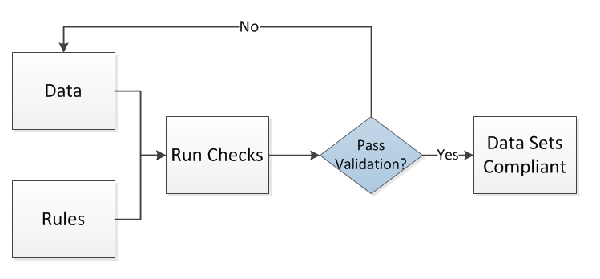
Compliance vs. Validation
Compliance implies that you are following all of the rules
Validation offers documentation that you have followed the rules
How much validation is enough to show compliance?

Slide 43

Lilly: Compliance vs. Validation
At Lilly:
Compliance or Integrity Checks → Metadata Checks
Validation Checks → Data Checks
Industry:
The terms Compliance and Validation are often used interchangeably
In general, Validation Checks are run to show Compliance to a given standard

Slide 44

Who Defines Rules?
CDISC ADaM Validation Team
Based on ADaM IG, TTE, ADAE (to include OCCDS in future releases of the checks)
FDA (currently SDTM only)
Sponsor
Based on internal Standards
Vendors who create tools

Slide 45


Rules, Checks, and Tools
Rules = Specification Document
CDISC ADaM Compliance Sub-Team has published ADaM Validation Checks v1.3
Checks
Programmed based on rules
Tools = Program/software to run checks
WebSDM
Pinnacle21 (formally OpenCDISC )
SAS Clinical Standards Toolkit
Sponsor Tools

Slide 46
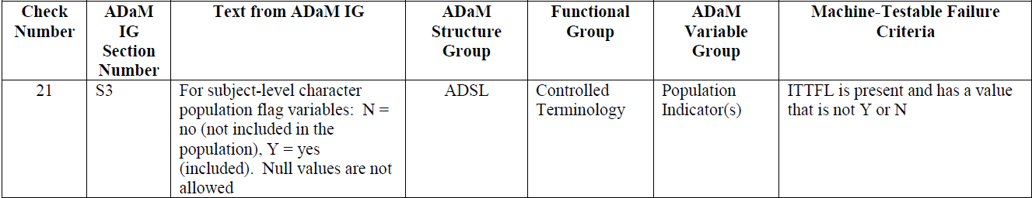
Example ADaM Validation Checks
Text from “ADaM IG Section Number” column may be modified to capture the essence of the text (not necessarily verbatim)
Machine-Testable Failure Criteria:
Programmable Test / Specification
Affirmative response represents a failure of the requirement

Slide 47

FDA Validation Rules
On November 18, 2014 the FDA published the first FDA SDTM Validation Rules
FDA includes some non-SDTM rules (not always consistent with CDISC documents)
– See FDA web site for full list
It is unclear when the FDA has plans to publish FDA ADaM Validation Rules – Sponsors should ASK!
http://www.fda.gov/forindustry/datastandards/studydatastandards/default.htm
Notes:
FDA Checks that are examples of non-SDTM rules
FDAC007: Missing VS dataset: Vital Signs (VS) dataset should be included in every submission
Data quality rule: FDAC106: --STDY is after --ENDY: Study Day of Start of Event, Exposure or Observation (--STDY) must be less or equal to Study Day of End of Event, Exposure or Observation (--ENDY)

Slide 48


Pinnacle21
Pinnacle21 provides tools to run checks on study data based on
Pinnacle21 defined rules
FDA defined rules (if any)
CDISC defined rules (although not always as intended)
Pinnacle21 does NOT contain all possible checks to check for compliance
2 versions - Community (free), Enterprise (fee based). Lilly will be using Enterprise version
http://www.pinnacle21.net/

Slide 49
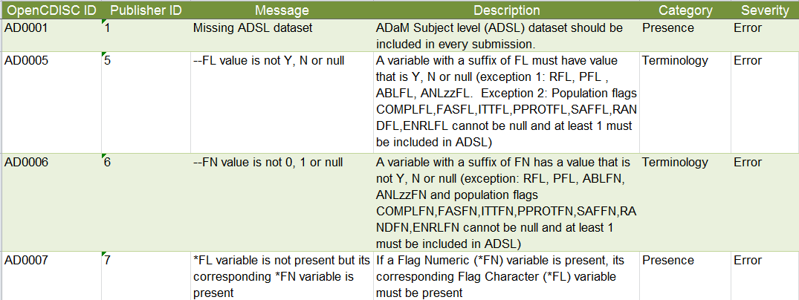
Pinnacle21 Example Checks
All Pinnacle21 checks can be found on the Pinnacle21 web site - Open “OpenCDISC Report”
Below are just a few of the hundreds of checks in Community Version

Slide 50
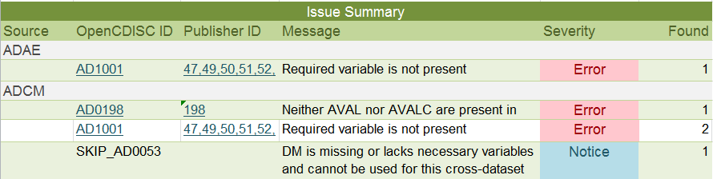
Example Pinnacle21 Output
Currently, only errors are returned for ADaM checks
Each error is broken down by Rule ID or Check #
May need to read ADaM check documentation AND ADaM IG to fully understand issue
If the issues is ok or cannot be resolved, the sponsor can explain in the Analysis Data Set Reviewer’s Guide (ADRG)

Slide 51

Possibility of Errors That Cannot be Fixed
Unfortunately, there is a risk of ‘false positive’ errors
A check may not be relevant for your study
Your study team has a valid reason for not following the rules
The check is not programmed correctly and shouldn’t have kicked out
Data quality issues found after database lock
What do you do when this happens?
Notes:
What to do when this happens? Discuss options such as documenting this in the Reviewer’s Guide (more to be covered in Mod 6)

Slide 52

Important Point!!!
Validation checks alone will NOT ensure compliance!
How do you know an ADaM variable is used correctly within a given data structure?
How do you know that ADaM metadata is clear and provides necessary traceability?
Many checks MUST be done manually

Slide 53
Important Point!!!
HIGHLY RECOMMEND: All sponsors define a list of checks to be checked manually.
This should include a ‘reality’ check of the metadata text that appears in the define.xml.
Is it readable?
Is it understandable?
Can someone unfamiliar with the project reproduce the primary efficacy results using metadata alone?

Slide 54
Lilly Module 2 Exercise #1

Slide 55
Lilly Mod 2 Exercise #1
Resources:
Use “Lilly Mod 2 Exercise” template (Lilly Mod 2 Ex. 1 tab)
CDISC Validation Checks (Lilly Mod 2 Ex. 1 tab)
ADAE data (Lilly Mod 2 Ex. 1 tab)
Exercise:
Based on the “CDISC Validation Checks” and the data in “ADAE data” determine what Validation Checks should kick out (or fire)
Do you notice any other issues with the ADAE data not based on the CDISC Validation Checks?

Slide 56
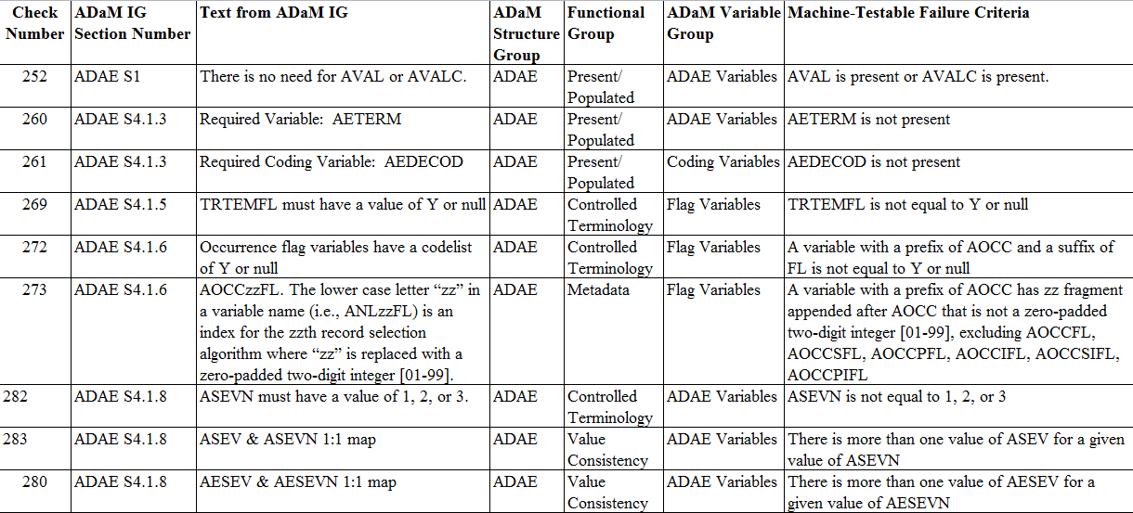
CDISC Validation Checks
Notes:
Move data into the exercise sheet for exercise
Clean up dupes in excel sheet
Copy data into intructions
Hard copy of data printed out for students.

Slide 57
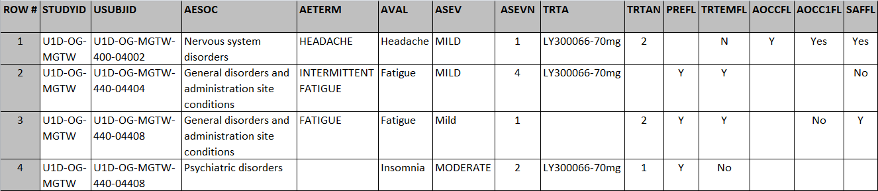
Based on the ADAE Data Set
Refer to ADAE Data Set in Lilly Mod 2 Exercise.xlsx (Lilly Mod 2 Ex. 1 ADAE Data tab)

Slide 58
Exercise #1 – Step by Step
Open Lilly Mod 2 Exercise spreadsheet, Ex. 1 tab, which contains the ADAE data and some of the CDISC Validation Check
Row(s) or Column(s): For each CDISC Validation Check, check the ADAE data to determine if the rule has been violated, and if so, identify the row(s) or column(s) with the issue
Explain in you own words Column: Explain which data violates the rule and why
Notes:
Read the instructions, leave this slide up and walk around the room to help trainees.

Slide 59
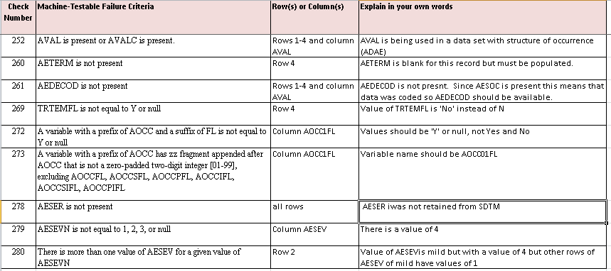
Lilly Mod 2 Exercise #1 Answer

Slide 60

Module 2 Summary
Accurate and informative ADaM metadata is the key to fulfilling the requirement of traceability
ADaM has rich metadata, including parameter value level metadata and analysis results metadata
The define.xml is a document that synthesizes the content of the metadata for a reviewer
The Analysis Data Reviewers Guide is a document that is highly recommended and provides an orientation to the submission
ADaM conformance is established both by using published compliance checks and by performing internal review

Slide 61
End of Module 2 ☺

